Slide 1

SMART FARMING SYSTEM &
CROP RECOMMEDATION

Slide 2

Team Members:
G.Sriram -AP23110011663
M.Kalyan -AP22110011633
M.Mahesh -AP23110011665
Y.Umesh -AP23110011667

Slide 3
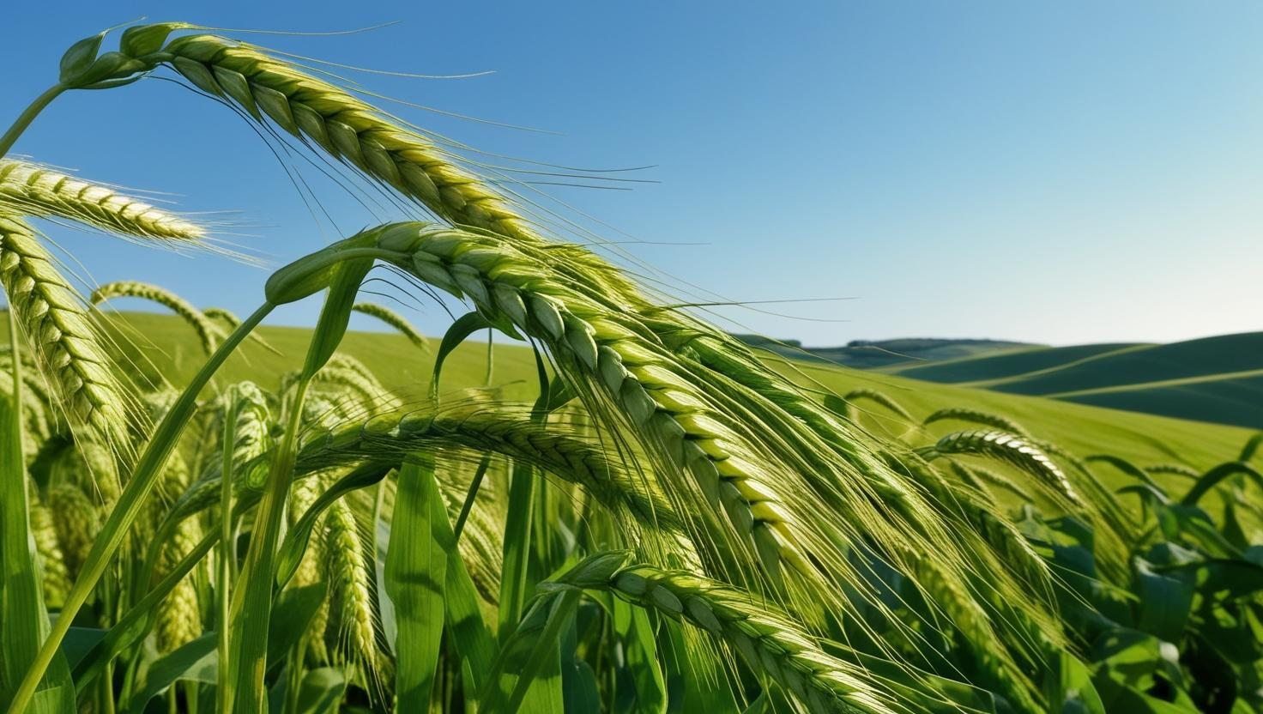
INTRODUCTION:
Traditional farming methods rely heavily on manual labor and guesswork.
Inconsistent weather patterns due to climate change affect crop yields.
Difficulty in early detection of crop diseases and pest infestations.Farmers face challenges in predicting the best crops for specific soil and climate conditions.
Difficulty in collecting, storing, and analyzing large volumes of farming data.
Farmers often struggle to choose the best crop for their soil type, climate, and past crop history, leading to poor yields.
Lack of personalized recommendations based on specific farm conditions (like soil pH, moisture, previous crops) limits productivity.

Slide 4
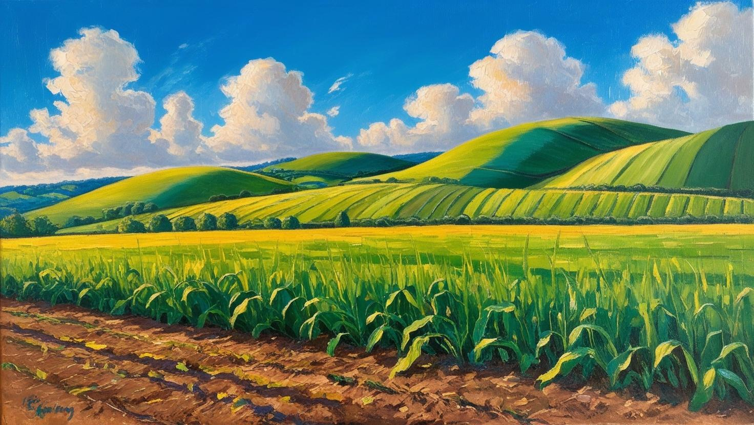
OBJECTIVES:
OBJECTIVES:
To monitor real-time soil, weather, and crop health data using IoT sensors.
To increase agricultural productivity while minimizing resource wastage.
To reduce manual labor dependency by introducing robotics and smart machinery.
To suggest the most suitable crops based on soil type, pH, moisture, and climate data.
To improve crop yield by considering historical farming patterns and soil health.
To support farmers in selecting crops that align with market demand and profitability.

Slide 5
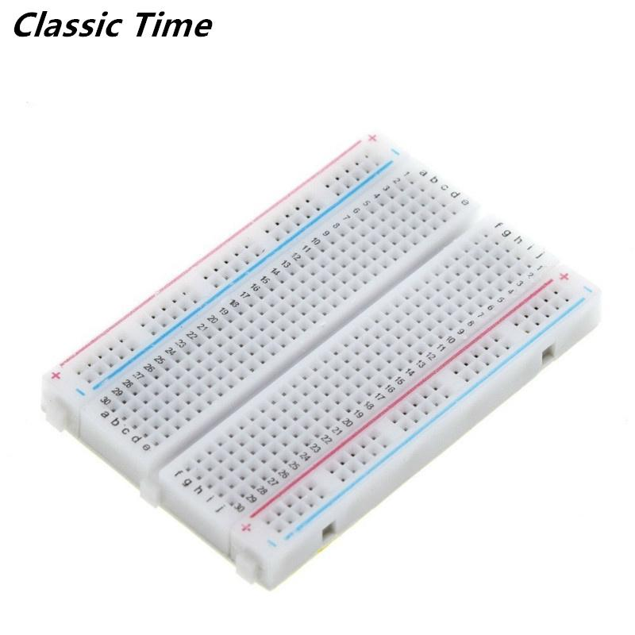
METHODOLOGY:
1. Hardware Setup:
ESP32 Microcontroller: Central controller for processing and communication
Sensors:
Temperature & Humidity Sensor (DHT11/DHT22)
Soil Moisture Sensor
Water Pump + Relay Module: For automatic irrigation control
Breadboard: Used for circuit connections during prototyping
2. Sensor Data Collection:
Real-time sensing of soil moisture, temperature, and humidity
Data sent to ESP32 for processing and decision making

Slide 6
3. Smart Irrigation Logic:
Threshold-based control:
If soil moisture < set value → Water pump is activated via relay
Else → Pump remains off
Helps in water conservation and maintaining ideal soil conditions
4. Crop Recommendation Logic:
Predefined crop database based on temperature, humidity, and soil moisture needs
ESP32 compares real-time values with ideal crop conditions
Outputs suitable crops for current conditions (can be displayed on web interface or serial monitor)
5. System Integration and Testing:
Hardware tested on breadboard setup
Continuous monitoring of sensor outputs
Pump response and crop suggestions verified for accuracy

Slide 7
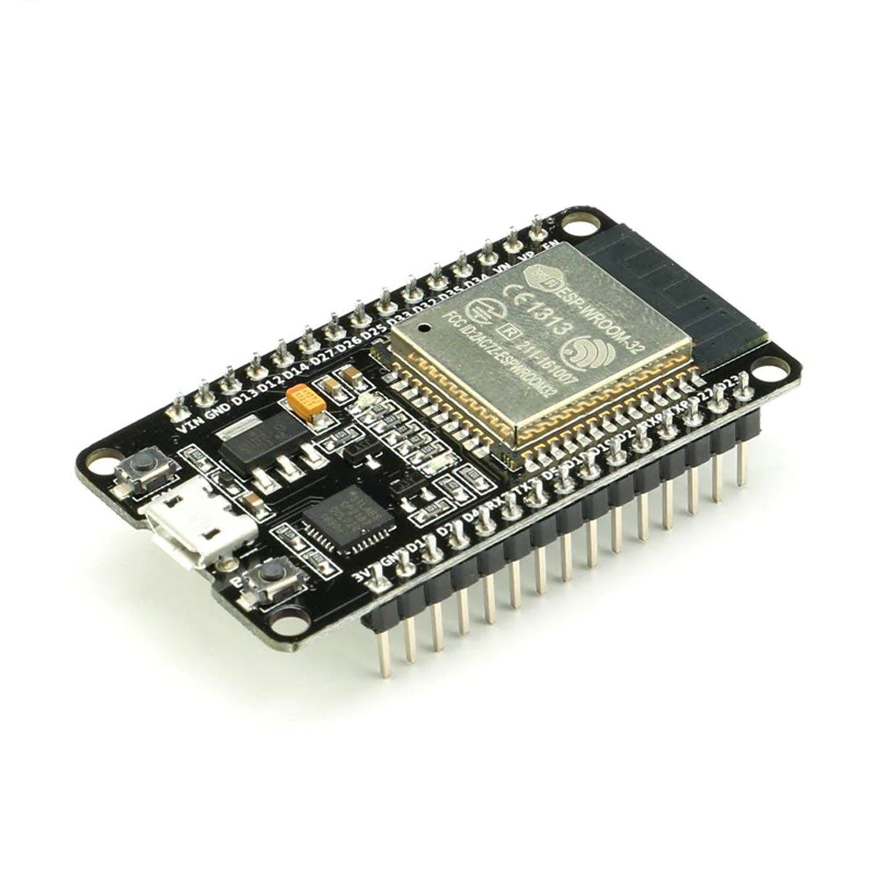
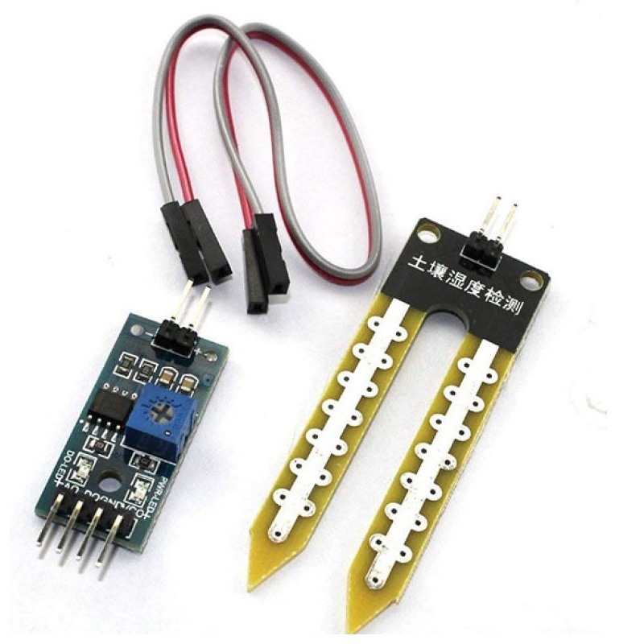
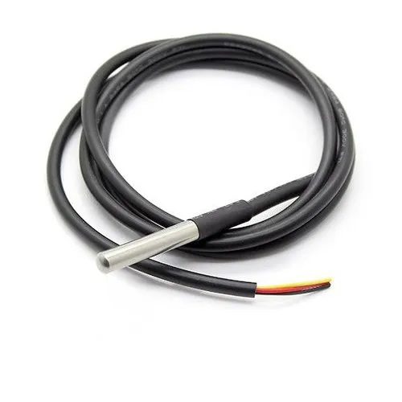
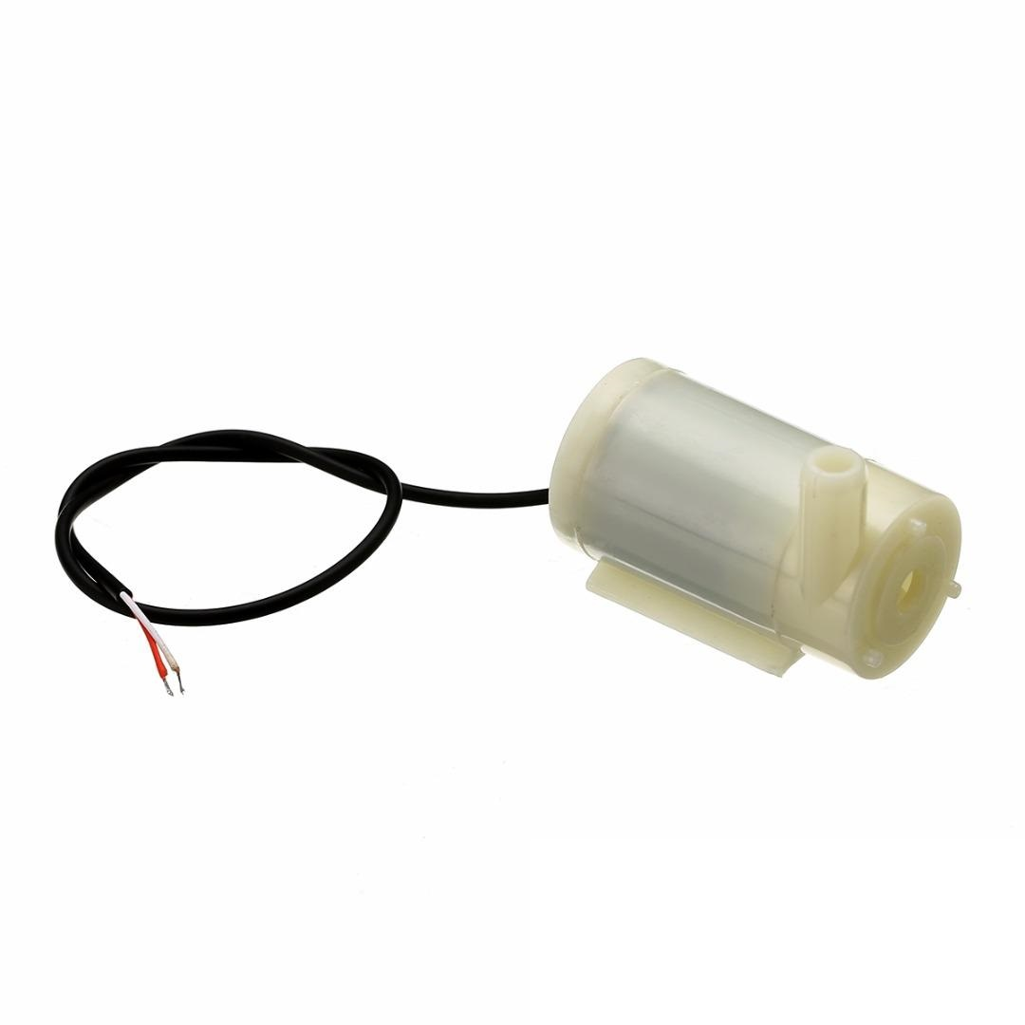
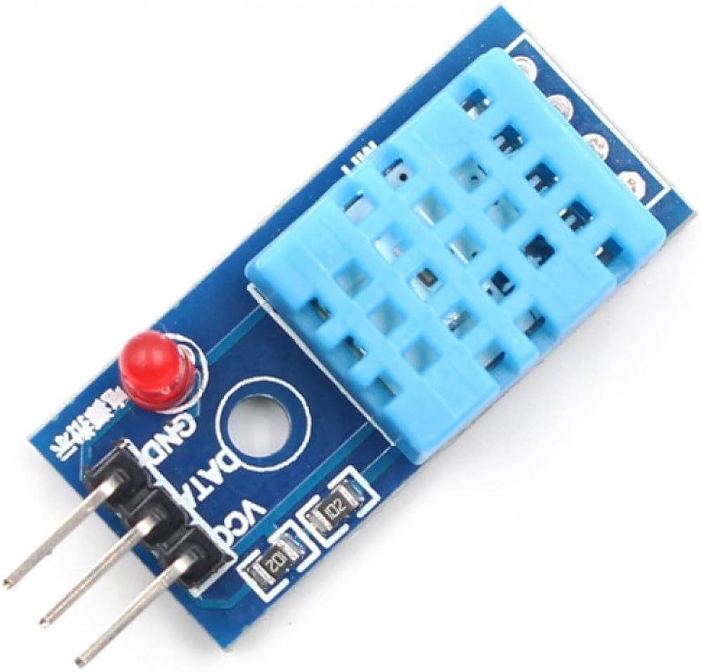
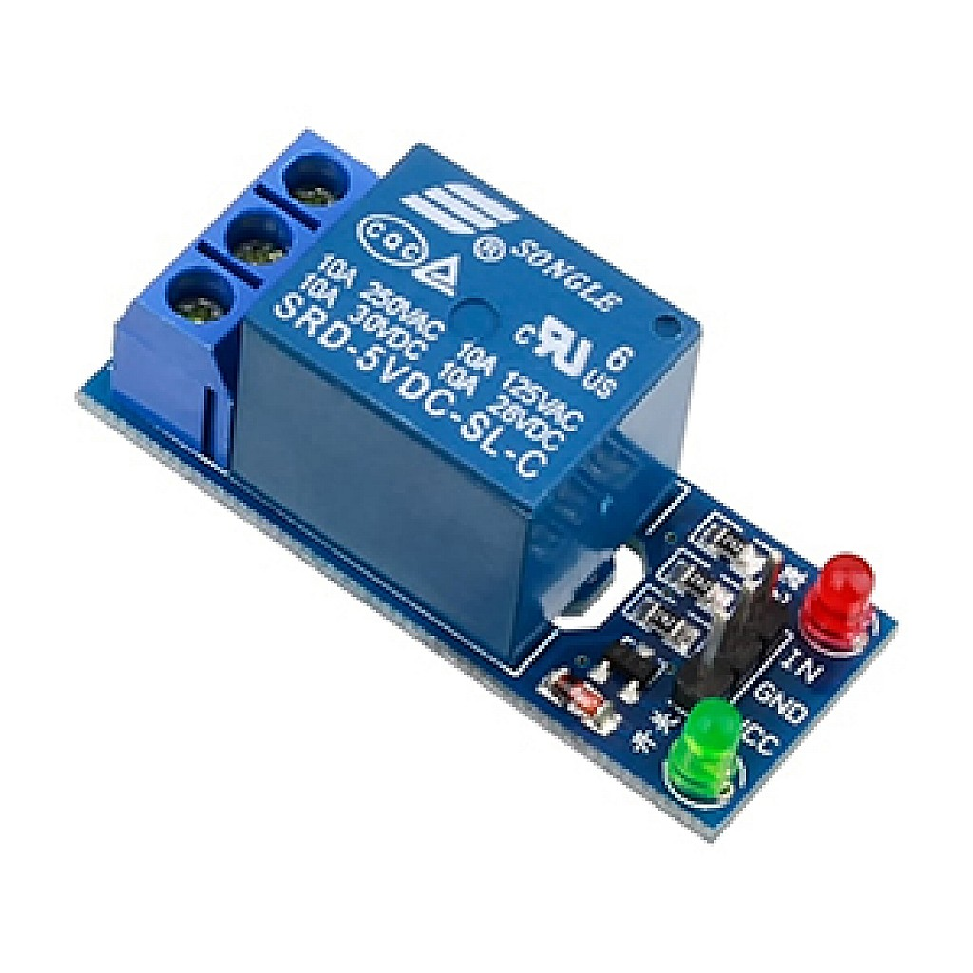

Slide 8
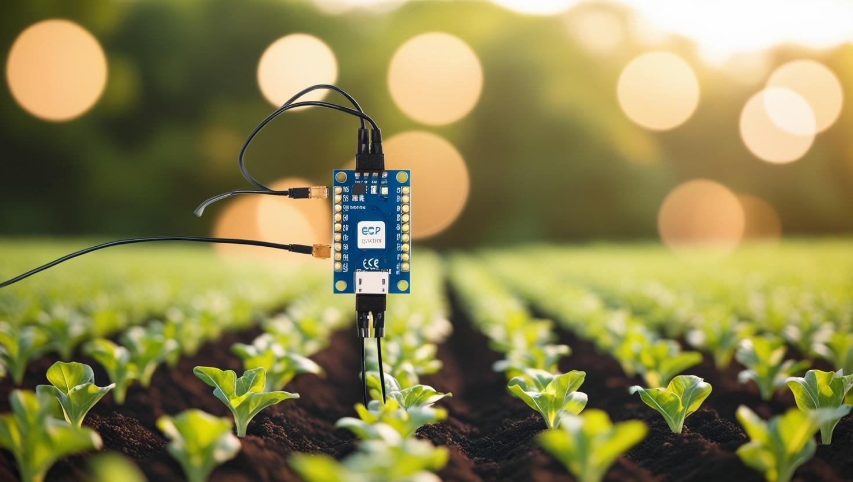
IMPLEMENTATION:
Smart farming using ESP32 and sensors involves integrating IoT technology to optimize agricultural processes. The ESP32 microcontroller collects real-time data from sensors like soil moisture, temperature, and humidity to monitor crop conditions. This data is processed and sent to a cloud platform for analysis, enabling farmers to make informed decisions and automate irrigation and climate control systems.

Slide 9
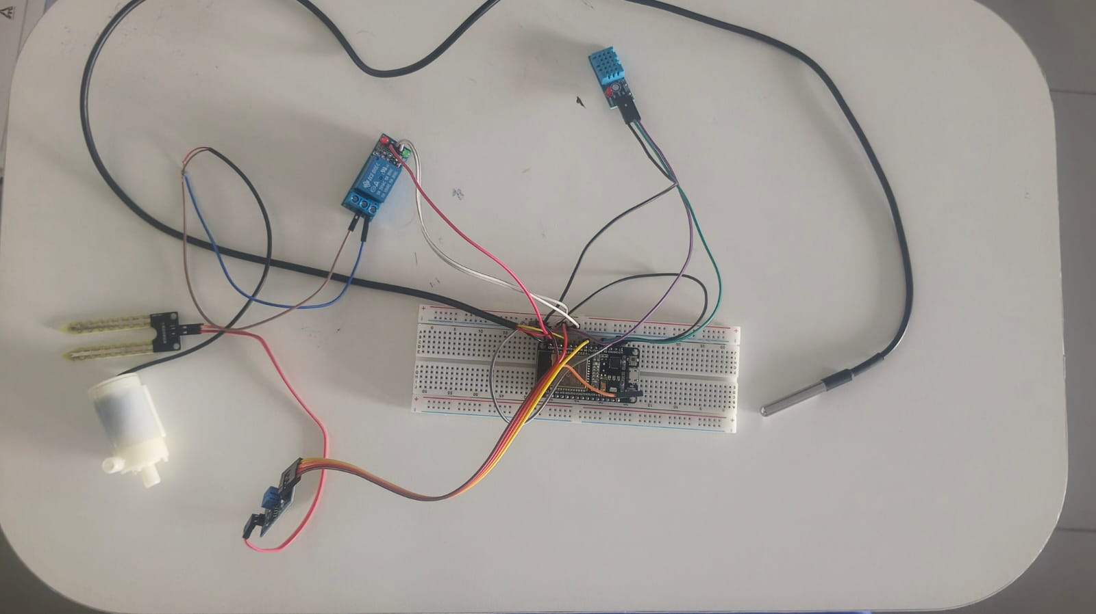
CIRCUIT DIAGRAM:

Slide 10
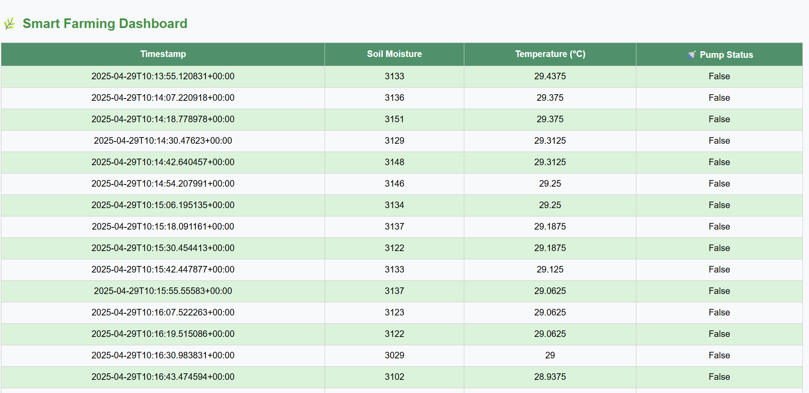
RESULTS:

Slide 11
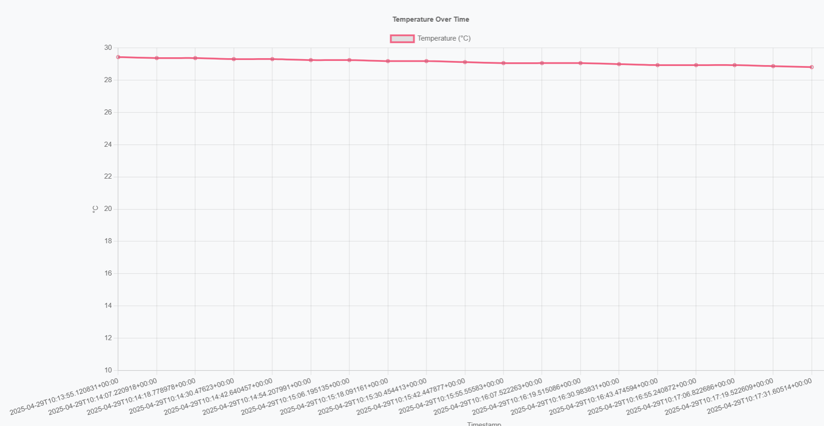
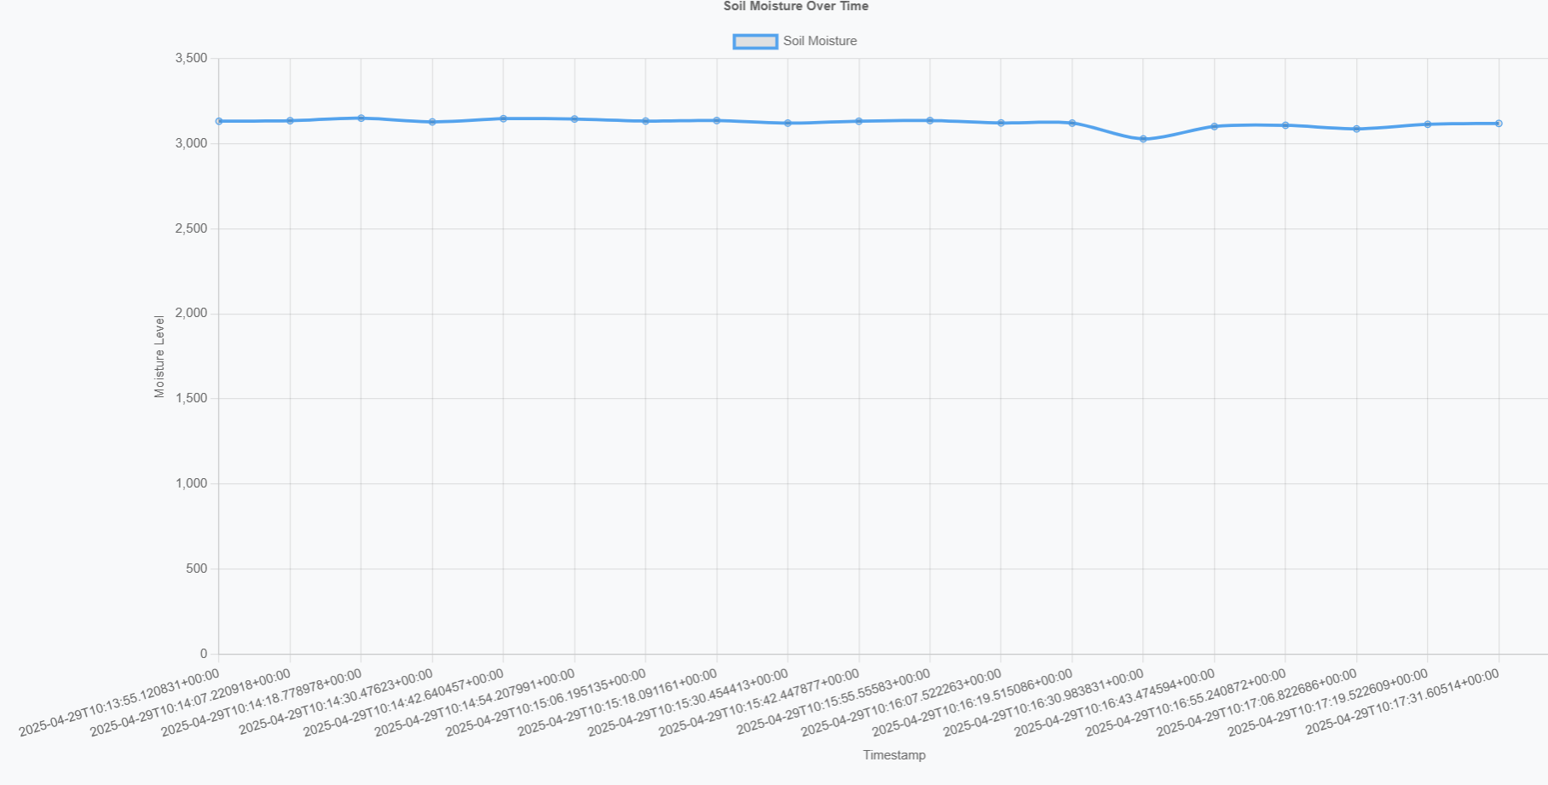
GRAPH:
Temperature Graph
Moisture Graph

Slide 12
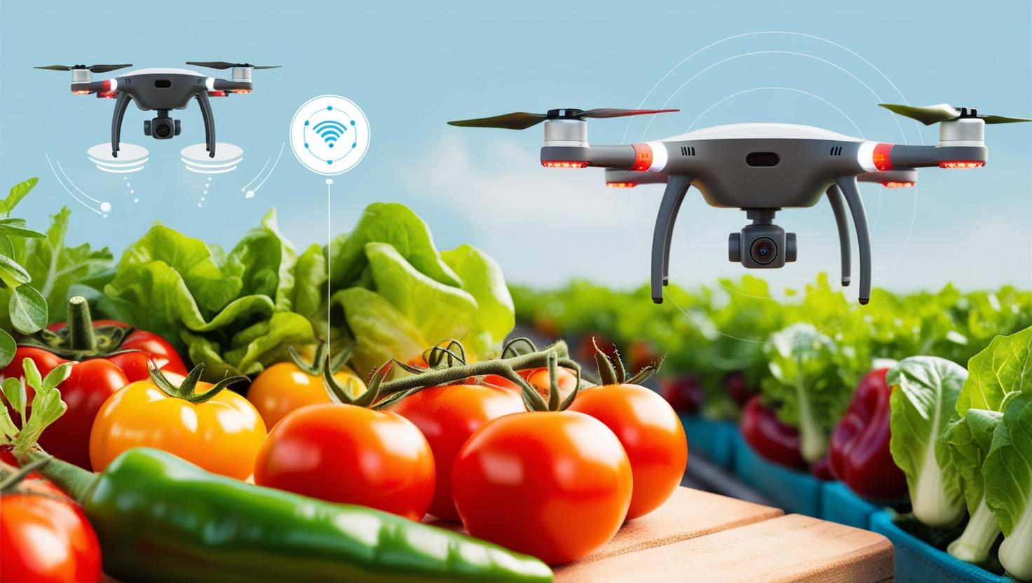
CONCLUSION:
This smart farming and crop recommendation system provides an efficient, affordable, and automated solution for modern agriculture. By using the ESP32 microcontroller along with temperature, humidity, and soil moisture sensors, the system enables real-time monitoring and automatic irrigation. AI-powered systems will enable automated decision-making based on real-time sensor and drone data.Integration with satellite data can further improve forecasting and large-scale farm management.Future farms will require robust wireless networks, such as LoRaWAN or 5G, for seamless data transmission.Renewable energy sources like solar panels will power remote sensors and devices sustainably.

